Slide 1

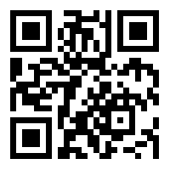

I think, therefore, I am.
Niharika Shrivastava

Slide 2
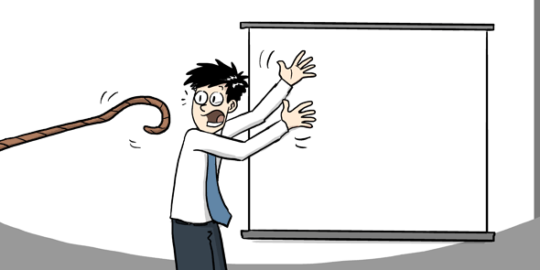
Talk Outline
My tech journey till now
Difficulties??
Open source opportunities
Outreachy & GSoC
Diversity Scholarships
Speaking/Mentorship
After Graduation
Your next steps!

Slide 3
Timeline
1st Year
Attended hackathons.
Coding contests.
WebD, AppD, ECE, Cyber Security, Foss, Design.
Studied :P
2nd Year
JS games, simple working applications using APIs.
Bigger OOM projects, websites.
Hacktoberfest, Outreachy, GSoC.
Tech events’ team member.
3rd Year
Projects in AI/ML/DL.
Campus internship.
MULTIPLE REJECTIONS from scholarships (Google, Microsoft).
Won SIH.
Selected in Outreachy.
4th Year
Won scholarships to various conferences, gave 3 talks.
More rejections, some acceptances.
RA at SUTD, Singapore.

Slide 4
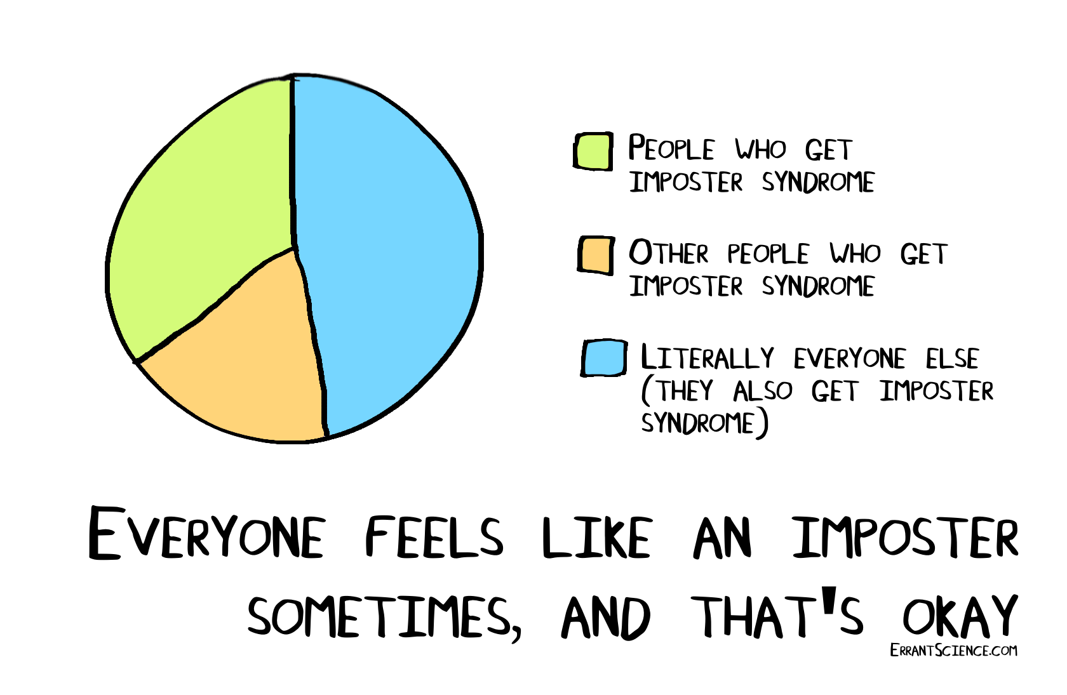
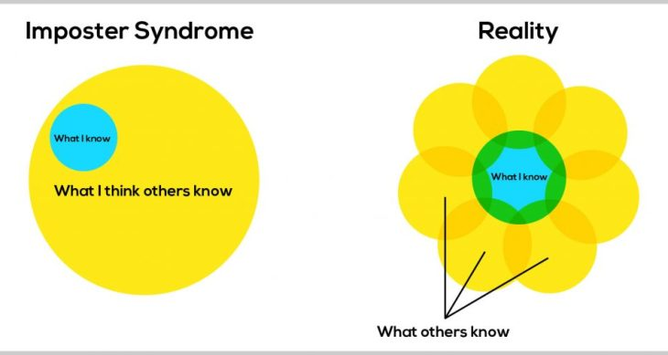
You think you’re not good enough?
Imposter Syndrome: Belief that you're an inadequate and an incompetent failure despite evidence that indicates you're skilled and quite successful. In short, it's a hot mess of harmfulness.

Slide 5
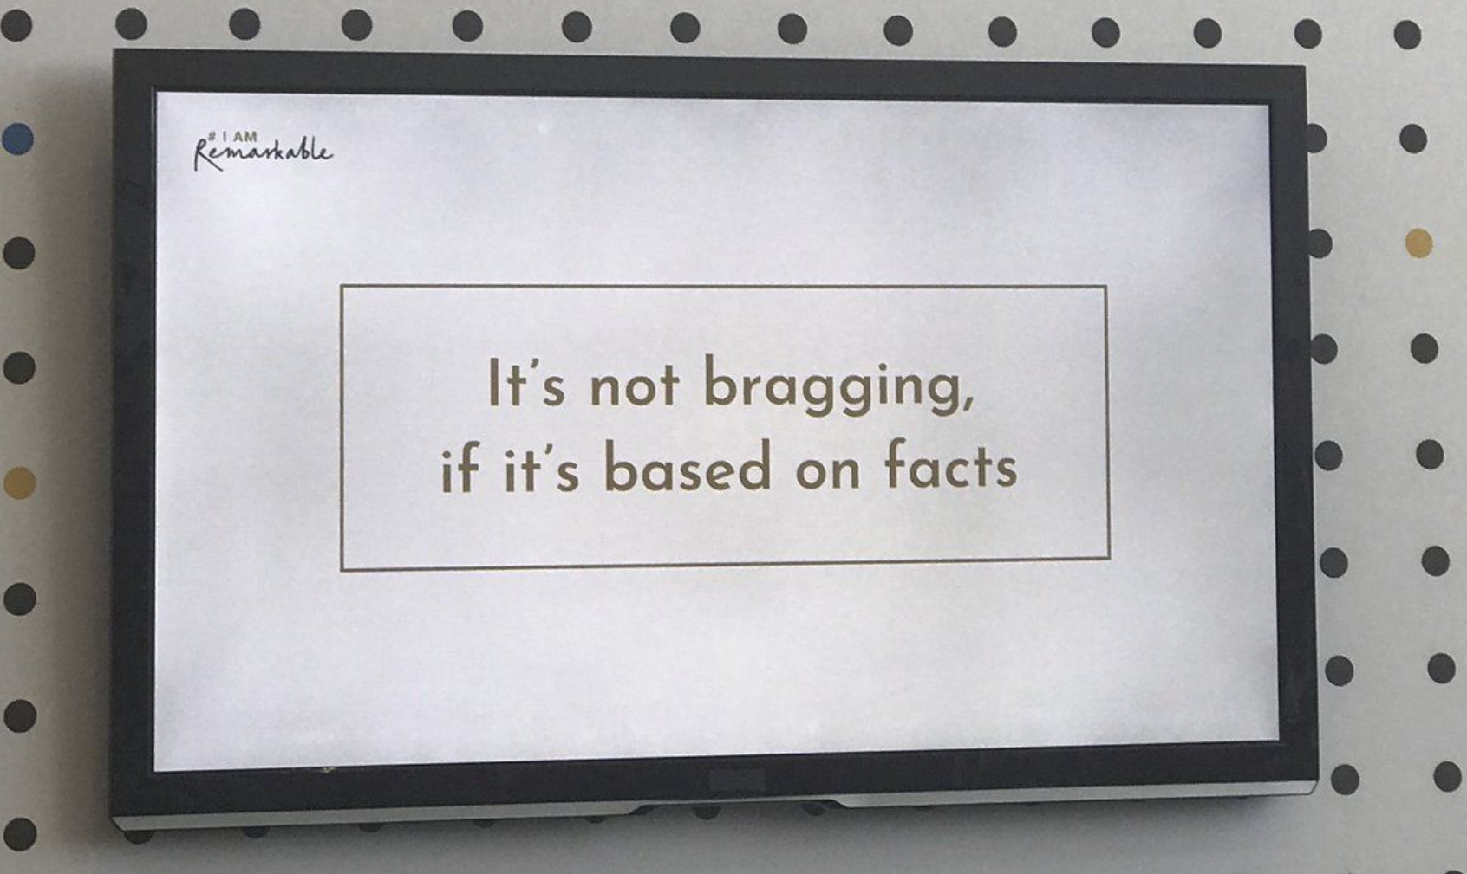
#IAmRemarkable

Slide 6
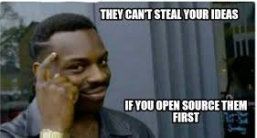
Opportunities in Open Source!

Slide 7
Outreachy
GSoC
May-Aug OR Dec-Mar
$5500 + $500 (travel)
Varying difficulty level
Thorough mentorship
Travel to events/conference
Can become mentors later
Regular chats, blog post prompts, alumni interactions
May-Aug
$1500
Varying difficulty level
Depends on org.
Depends on org.
Can become mentors later
Depends on org.

Slide 8
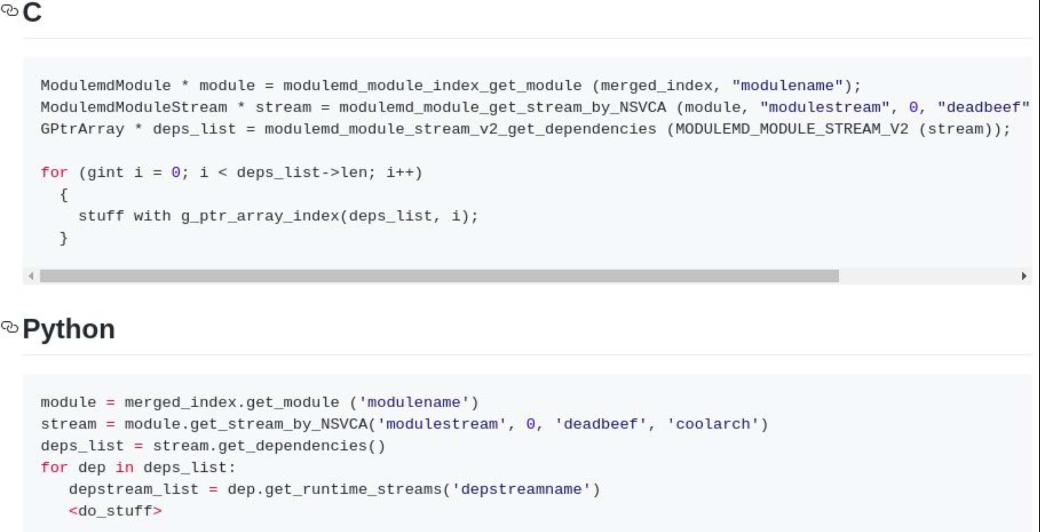
Documentation Example

Slide 9
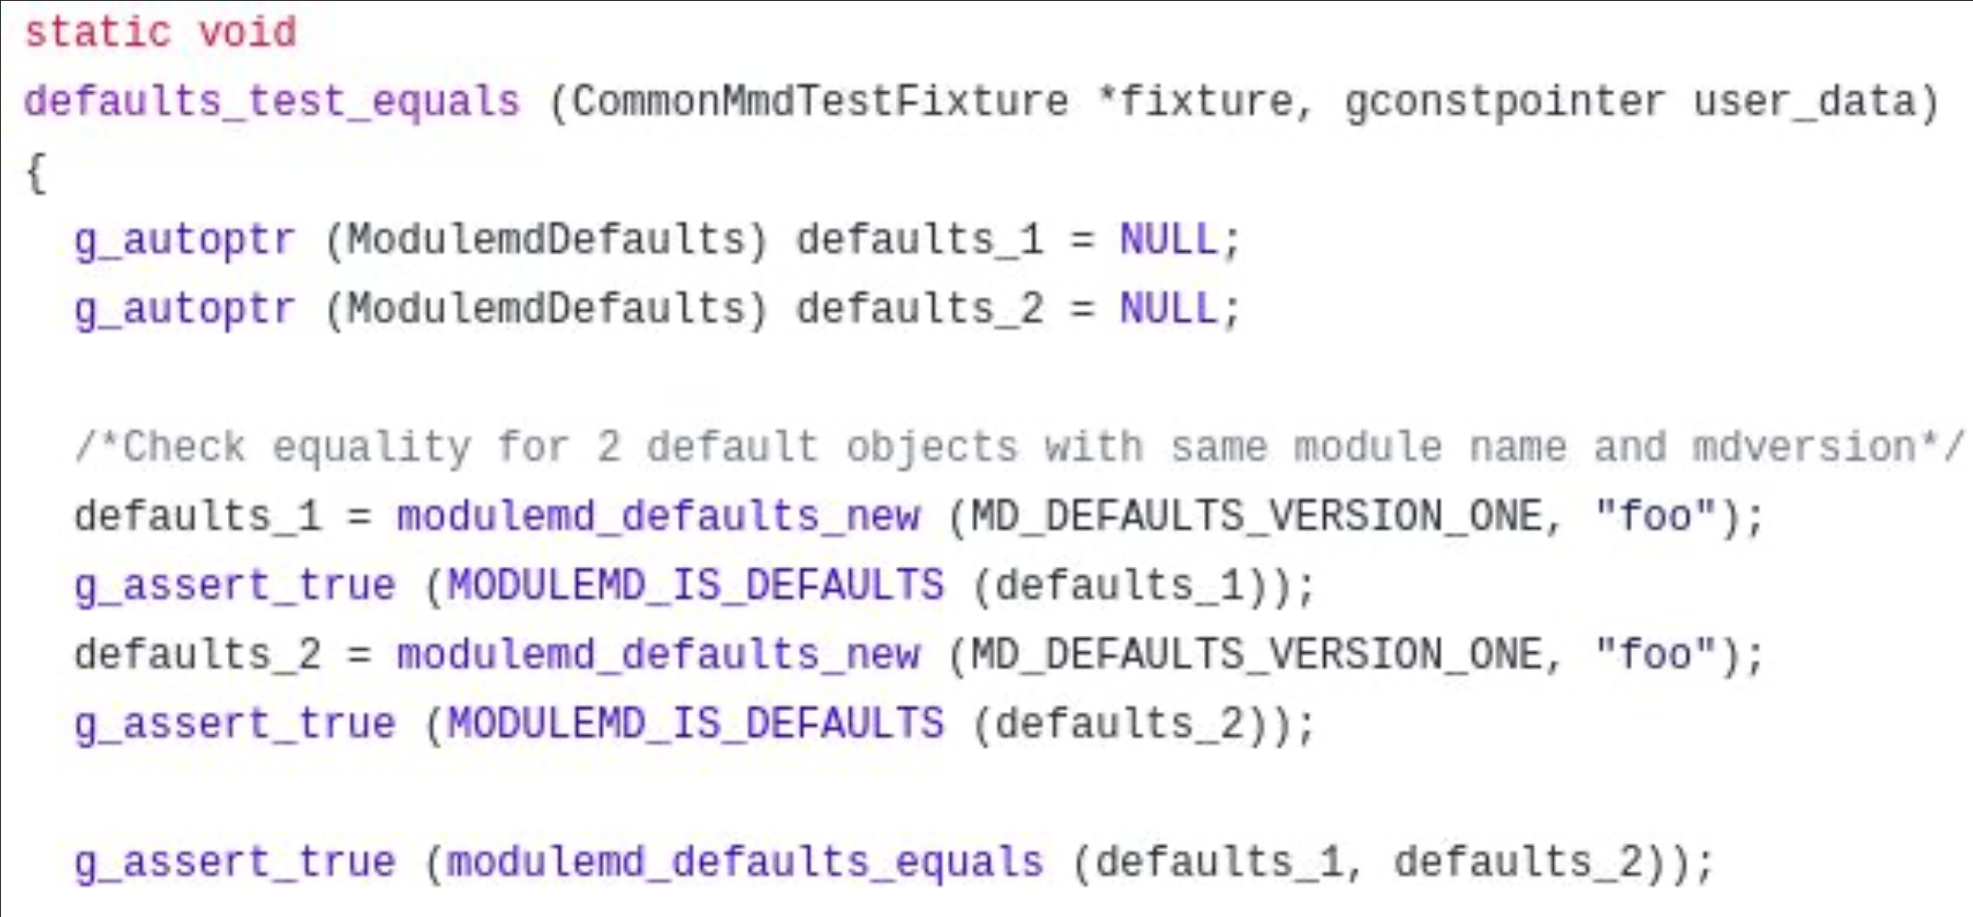
Testing Example

Slide 10
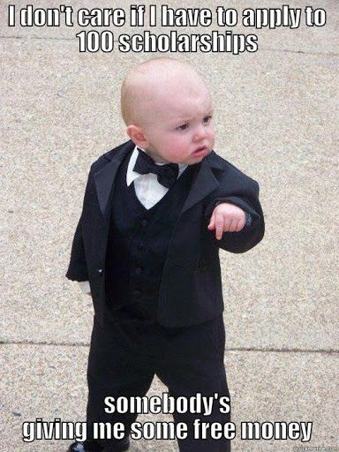
Diversity Scholarships
Google scholarships:
Women Techmakers
Grace Hopper Conference, GHC India
Venkat Panchapakesan Memorial Scholarship
Linux Foundation Scholarships:
Conference Diversity
LiFT
Red Hat scholarships:
Conference Diversity
Women in Open Source Awards
Adobe Research scholarship
Fund toward tuition fees for the remainder university education.
Nutanix Women in Technology Scholarship
Offering 10 scholarships to female students
Application Date: November/December
Lady Meherbai D Tata Education Scholarship
Funds to graduate Indian women who wish to study in US, UK or Europe to pursue higher education.
Application Date: April/May

Slide 11
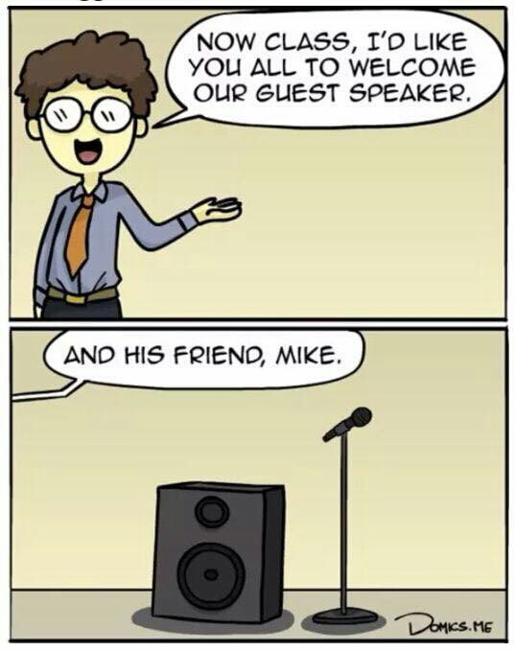
Speaking / Mentorship opportunities
Submit proposals in conferences, universities (CFPs):
Lightning talks (5-10 mins)
Sessions (30-45 mins)
Poster Presentation
Panel Discussions
Google Code-In/GSoC/GSoD
Girlscript Summer of Code
DSC-led open source events

Slide 12
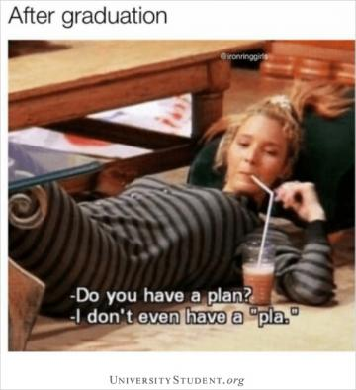
After graduation
Industrial job.
Graduate degrees (Masters).
Direct PhD (Fundings available).
Research Fellowships.
Startups.
Freelancing/Consultancy.
Be involved in the open source community.

Slide 13

Your next steps
Participate in hackathons.
Become team members, participants in developer groups(PyLadies).
Attend various conferences(virtual/physical).
Code.
Communicate your ideas.
Build your resume.
Be Fearless. → I think, therefore, I am.
HAVE FUN!

Slide 14
Thank You!
LinkedIn
Website
Email

